Slide 1
WYKE REGIS AND LANEHOUSE PRACTICE FRIENDS
(WITH CHICKERELL): UPDATE: JANUARY 2020
In the beginning …….. In Autumn 2018 the practice joined the NHS initiative “Altogether Better” to develop Collaborative Practice, an award-winning model, which helps health services and local people find new ways of working together – making a difference to people’s lives, releasing resources, and improving services. Local people are invited to gift their time to a local GP practice or health service, working alongside people who deliver health services in a collaborative relationship. At our practice this resulted in the establishment of the “Friends”. After an initial training session the first meeting was held in February 2019.
A year later …….. a range of activities have been developed
Tuesday Teas Together
Leg Clubs
Patient Services Directory
Leg Clubs are a research-based initiative providing treatment, health promotion, education and ongoing care for people who are experiencing leg related problems such as ulcers. Friends have supported the Clinical Lead Demelza Spencer-Veale to establish a leg club every weekday morning in Weymouth.
http://twoharbourshealthcare.co.uk/leg-club/
The Directory provides information on a range of activities in the area served by the practice and in and around Weymouth spanning social, sport, exercise, art and craft events and community plus patient support groups/advice services to help patients improve their own health, wellbeing and social welfare. A paper copy is available in each surgery and via the practice website
Wyke Regis Health Centre
2 - 4 pm each Tuesday: come along and join us
https://www.wykeregisandlanehousemedicalpractice.co.uk/
New for 2020 …….. activities include
The Practice Allotment: come an join us digging, weeding, hoeing and planting and reap the fruits of your labours
Befriending: We are hoping to establish a befriending schemes
offer companionship and support to our patients
For further information please contact the practice or email wykefriends@gmail.com
Did you know residents of Wyke Regis can access services provided by Island Community Action (ICA)? This includes transport; befriending; singing and exercise classes. See attached map for details of areas of Wyke covered by ICA and ring 01305 823789 for further details or visit the ICA Website www.islandcommunityaction.org or email office@islandcommunityaction.org.uk

Slide 2
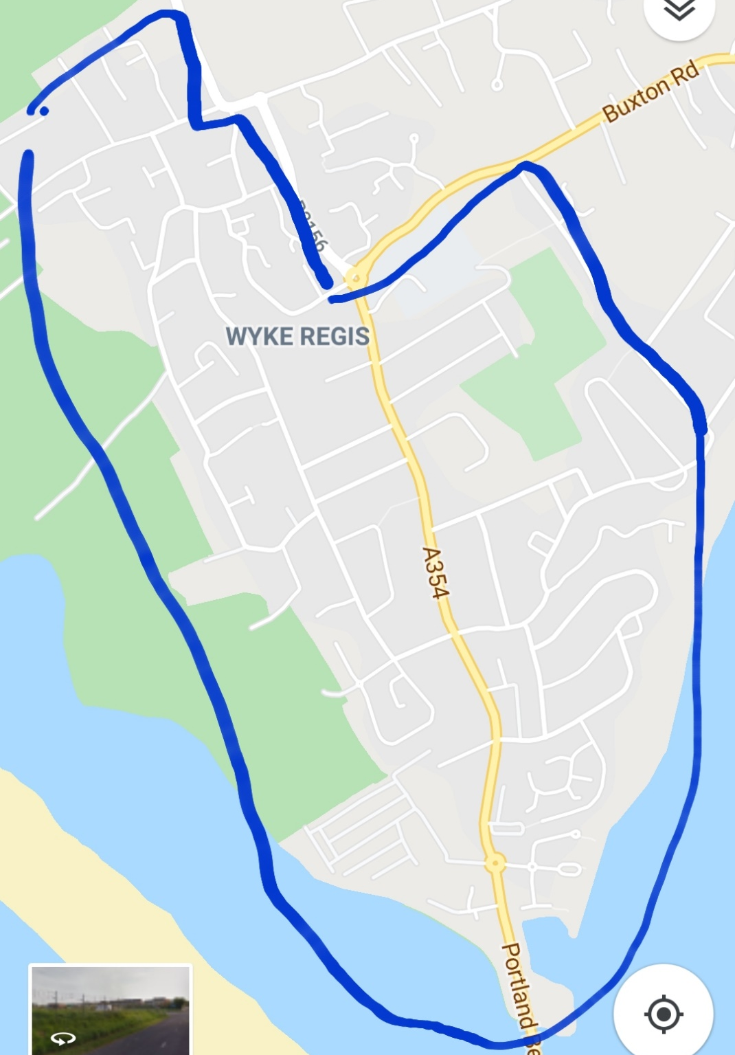
The area covered by ICA in Wyke is from:
The top of Lanehouse Hill, West of Portland Road to Fords Corner roundabout and South of Buxton road to Rylands Lane.

